Slide 1
Decision Trees
Dr. Uzair Ahmad

Slide 2
Big Picture of Learning
Learning can be seen as fitting a function to the data. We can consider
different target functions and therefore different hypothesis spaces.
Examples:
Propositional if-then rules
Decision Trees
First-order if-then rules
First-order logic theory
Linear functions
Polynomials of degree at most k
Neural networks
Java programs
Turing machine
Etc
A learning problem
is realizable if its hypothesis space contains the true function.
Tradeoff between
expressiveness of a hypothesis space
and the
complexity of finding simple, consistent hypotheses
within the space.
Prof. Bart Selman, Cornell Univ

Slide 3
Decision Tree Learning
Task:
Given: collection of examples (x, f(x))
Return: a function h (hypothesis) that approximates f
h is a decision tree
Input: an object or situation described by a set of attributes (or features)
Output: a “decision” – the predicts output value for the input.
The input attributes and the outputs can be discrete or continuous.
We will focus on decision trees for Boolean classification:
each example is classified as positive or negative.

Slide 4
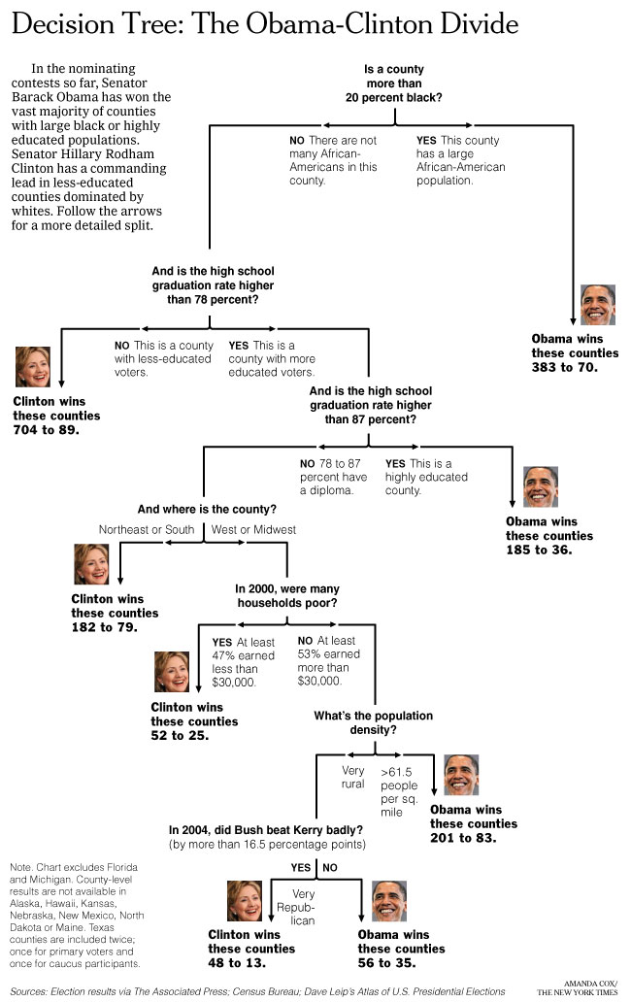
Can we learn
how counties vote?
New York Times
April 16, 2008
Decision Trees:
a sequence of tests.
Representation very natural for humans.
Style of many “How to” manuals and trouble-shooting
procedures.

Slide 5
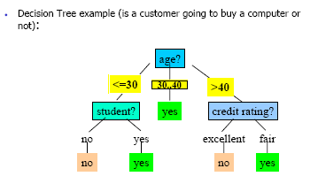
Decision Tree
What is a decision tree?
A tree with two types of nodes:
Decision node: Specifies a choice or test of some attribute with 2 or more alternatives;
→ every decision node is part of a path to a leaf node
Leaf node: Indicates classification of an example

Slide 6
Inductive Learning Example
Etc.
Instance Space X: Set of all possible objects described by attributes (often called features).
Target Function f: Mapping from Attributes to Target Feature (often called label) (f is unknown)
Hypothesis Space H: Set of all classification rules h_{i} we allow.
Training Data D: Set of instances labeled with Target Feature

Slide 7
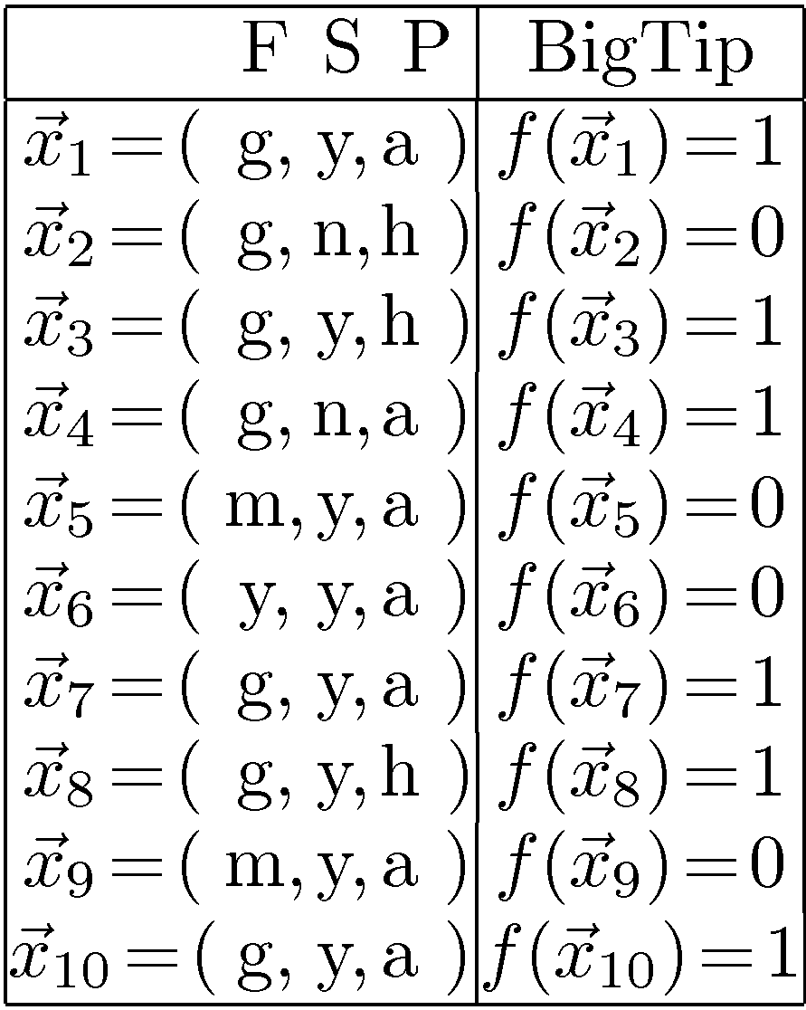
Decision Tree Example: “BigTip”
great
Food
yuck
mediocre
Speedy
no
no
no
yes
Our data
yes
Price
high
adequate
yes
no
Is the decision tree we learned consistent?
Yes, it agrees with all the examples!
Notes:
Definition of components
Internal nodes: tests on attributes
Branches: attribute value (one branch for each value)
Leaves: assign classification
Understanding example tree
Classify Example 1: yes
Classify Example 2: yes
Classify Example 3: no
Classify Example 4: yes
Classify: $x_2=(Food=great, Chat=no, Fast=no, Price=adequate, Bar=no)$ $\rightarrow$ yes
Example represents function: (Food=great) AND ((Fast=yes) OR ((Fast=no) AND (Price=adequate))) → Simplify to: (Food=great) AND ((Fast=yes) OR (Price=adequate))
How would you represent:
A AND B
A OR B
A XOR B

Slide 8
Decision Tree Classification
A decision tree represents a function that takes as input a vector X_{i} of attribute values and returns a "decision“ Y—a single output value.
Y = f( X_{i} )
The input and output values can be discrete or continuous.
If the output has exactly two possible values; this is called Boolean classification
Stuart Russel, AI A Modern Approach, Ch 18, Pg 698

Slide 9
A Decision Tree
A decision tree reaches its decision by performing a sequence of tests.
Each internal node in the tree corresponds to a test of the value of one of the input attributes, Ai. and the branches from the node are labeled with the possible values of the attribute, Ai = x.
Each leaf node in the tree specifies a value to be returned by the function.
The decision tree representation is natural for humans;
Many "How To" manuals (e.g., for car repair) are written entirely as a single decision tree stretching over hundreds of pages.
Stuart Russel, AI A Modern Approach, Ch 18, Pg 698

Slide 10
Learning decision trees: An example
Problem: decide whether to wait for a table at a restaurant. What attributes would you use?
Attributes used by R&N
Alternate: is there an alternative restaurant nearby?
Bar: is there a comfortable bar area to wait in?
Fri/Sat: is today Friday or Saturday?
Hungry: are we hungry?
Patrons: number of people in the restaurant (None, Some, Full)
Price: price range ($, $$, $$$)
Raining: is it raining outside?
Reservation: have we made a reservation?
Type: kind of restaurant (French, Italian, Thai, Burger)
WaitEstimate: estimated waiting time (0-10, 10-30, 30-60, >60)
What about
restaurant name?
It could be great for
generating a small tree
but …
Goal predicate: WillWait?
It doesn’t generalize!

Slide 11
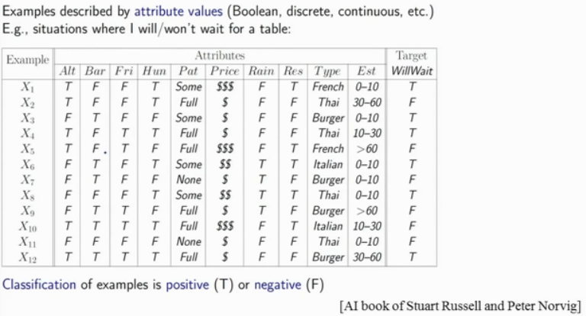
Example Data Set (10 Attributes/Dimensions)
Alternate Restaurant
Waiting Area
Customers sitting inside
12 Customer

Slide 13
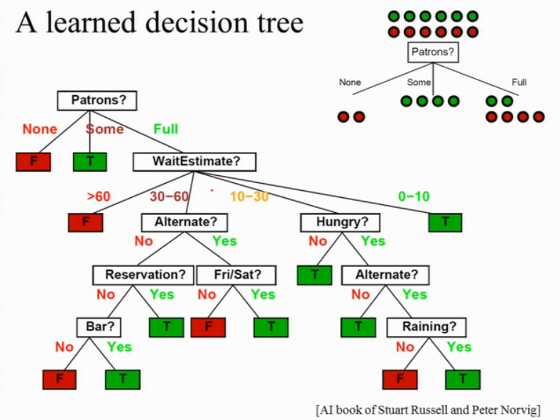
Each branch /Path ends on Leaf.

Slide 14
Notice that the tree ignores the Price and Type attributes.

Slide 15
Decision Tree Expressiveness
For a wide variety of problems, the decision tree format yields a nice, concise result.
But some functions cannot be represented concisely.
For example, the majority function, which returns true if and only if more than half of the inputs are true
requires an exponentially large decision tree.
There is no representation that is efficient for all kinds of functions

Slide 16
Truth Tables
Consider the set of all Boolean functions on n attributes.
How many different functions are in this set?
This is just the number of different truth tables that we can write down, because the function is defined by its truth table.
A truth table over n attributes has 2^{n} rows, one for each combination of values of the attributes.

Slide 17
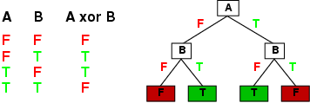
Expressiveness
Decision trees can express any Boolean function of the input attributes.
E.g., for Boolean functions, truth table row → path to leaf:

Slide 18


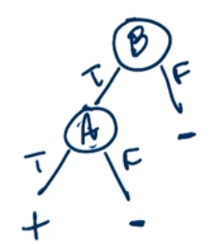
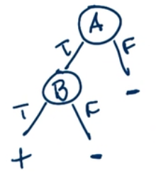
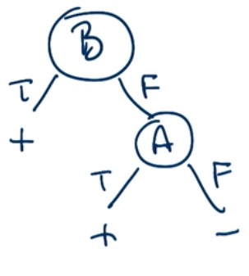
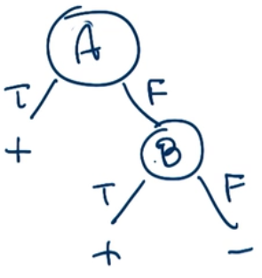
Decision Trees of Boolean Functions
Mirrors
Borrowed from Udacity

Slide 19

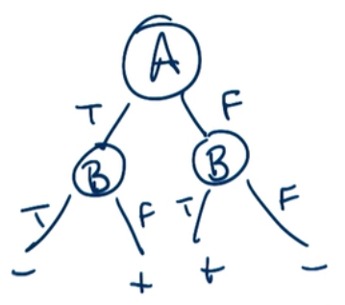
Decision Trees of Boolean Functions
Borrowed from Udacity

Slide 20
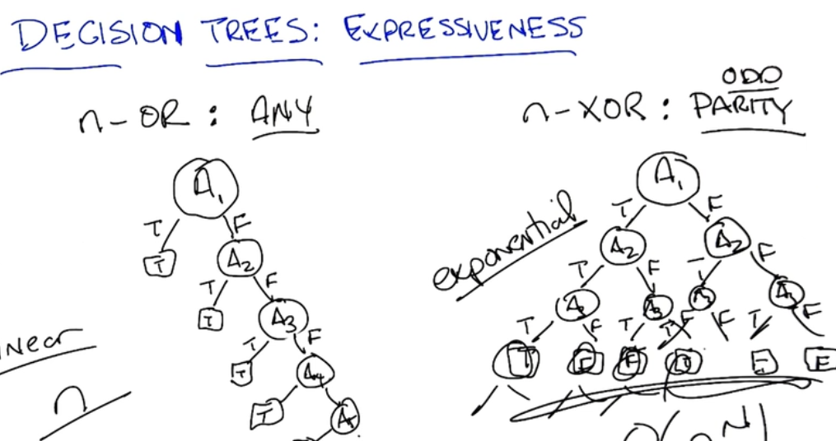
Decision Trees of Generalized Boolean Functions
Borrowed from Udacity

Slide 21
Number of Distinct Decision Trees
XOR is hard and OR is easy
In terms of the number of nodes
While building a DT, we don’t know which function we are building.
If we have to search all possible decision trees to find the best one, how many decision trees we have to worry about to look at ?
Borrowed from Udacity

Slide 22
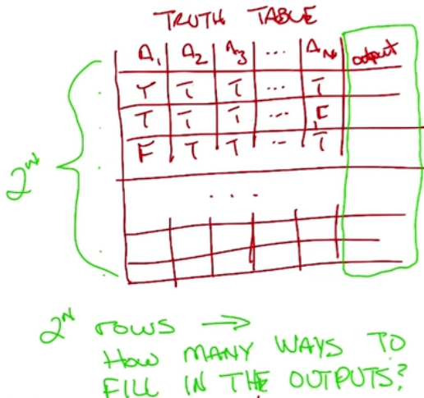
Number of Distinct Decision Trees
Borrowed from Udacity

Slide 23
Number of Distinct Decision Trees
How many distinct decision trees with 10 Boolean attributes?
= number of Boolean functions with 10 propositional symbols
Input features Output
0 0 0 0 0 0 0 0 0 0 0/1
0 0 0 0 0 0 0 0 0 1 0/1
0 0 0 0 0 0 0 0 1 0 0/1
0 0 0 0 0 0 0 1 0 0 0/1
…
1 1 1 1 1 1 1 1 1 1 0/1
How many entries does this table have?
2¹⁰
So how many Boolean functions
with 10 Boolean attributes are there,
given that each entry can be 0/1?
= 2²¹⁰

Slide 24
Hypothesis spaces
How many distinct decision trees with n Boolean attributes?
= number of distinct truth tables with 2^{n} rows
= number of Boolean functions = 2^{2n}
With 6 Boolean attributes, there are 18,446,744,073,709,551,616 possible trees!
E.g. how many Boolean functions on 6 attributes? A lot…

Slide 25
Decision tree learning Algorithm
Decision trees can express any Boolean function.
Goal: Finding a decision tree that agrees with training set.
We could construct a decision tree that has one path to a leaf for each example.
Overall Goal: get a good classification with a small number of tests.
What is the problem with this from a learning point of view?
Problem: This approach would just memorize examples. How to deal with new examples? It doesn’t generalize!
We want a compact/smallest tree.
But finding the smallest tree consistent with the examples is NP-hard!
Non-deterministic Polynomial-time

Slide 26
Picking the Best Attribute to Split
Ockham’s Razor:
All other things being equal, choose the simplest explanation
Decision Tree Induction:
Find the smallest tree that classifies the training data correctly
Problem
Finding the smallest tree is computationally hard ☹!
Approach
Use heuristic search (greedy search)
Key Heuristics:
Pick attribute that maximizes information (Information Gain)
i.e. “most informative”
Other statistical tests
Notes:
Trivial Tree: Full tree with full depth, just label the nodes.

Slide 27
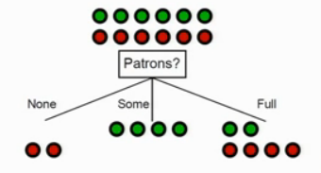

Slide 28
Est
0,10
10-30
30-60
>60

Slide 29
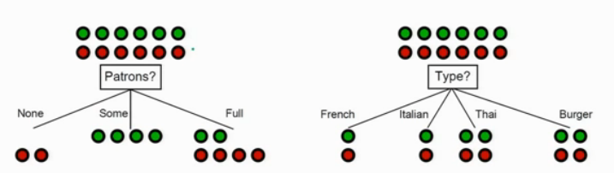
Learning Decision Tree
The first decision to make ?
Which attribute is going to be the root of the tree?
Which attribute explains the most whether customer will wait or not ?

Slide 30
Learning Decision Tree
Why Restaurant Type is not a better attribute to make the root of the tree ?
It delays the decision, up to next level of node.
That waists resources [time/memory/processing].

Slide 31
How to Pick Nodes
We want to determine which attribute in a given set of training feature vectors is most useful for discriminating between the classes to be learned.
The Information gain tells us how important a given attribute of the feature vectors is.
We will use it to decide the ordering of attributes in the nodes of a decision tree.

Slide 32
Information Gain
Reduction in Entropy for the attribute A
Entropy of
the
Parent Node
Entropy of the
Child Nodes

Slide 33
Entropy
The homo/heterogeneity (im/purity) of a set of examples.
The information content of the set in terms of the class labels of the examples.
7 Red
7 Blue

Slide 34
Entropy
14 Red
7 Red
0 Blue
7 Blue
Minimum impurity (Entropy)
Bad training set for learning
Maximum impurity (Entropy)
good training set for learning

Slide 35
Entropy Formula
Consider Set S with two classes, P and N.
Let the set have p instances for the class P and n instances for the class N.
So the total number of instances we have is
t = p + n.
The [p, n] can be seen as a class distribution of S.
The entropy for S is defined as
Entropy[p, n] = - (p/t).log₂(p/t) - (n/t).log₂(n/t)

Slide 36
Entropy Numerical Examples
Entropy[7,7 ] =-(7/14).log₂(7/14)-(7/14).log₂(7/14)
= -(0.50)(-1) - (0.50)(-1) = 1
Entropy[14,0] =-(14/14).log₂(14/14)-(0/14).log₂(0/14)
= -1.log₂(1) - 0.log₂(0) = 0 – 0 = 0
Entropy[9,7] = - (9/14).log₂(9/14) - (5/14).log₂(5/14)
= -(0.64)(-0.63) - (0.35)(-1.48)
= (0.40982) + (0.53056) = 0.94

Slide 37
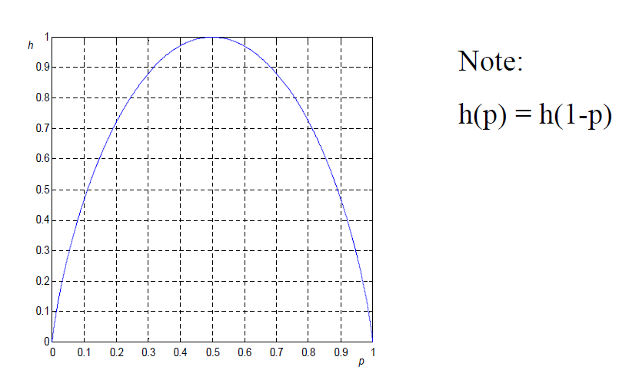
A 2-Class Entropy Curve
The higher the entropy the more the information content
Entropy
Proportion of Positive Examples in Set S

Slide 38
Information Gain
Reduction in Entropy for the attribute A

Slide 39
Average Entropy
A chosen attribute A, with K distinct values,
A divides the training set E into subsets E1, …, Ek
The Expected Entropy (EH) remaining after trying attribute A (with branches i-1,2,…,k)
Parent Node A
Child 1
Child 2
Child k

Slide 40
Information Gain
We want to determine which attribute in a given set of training feature vectors is most useful for discriminating between the classes to be learned.
Information gain tells us how important a given attribute of the feature vectors is.
We will use it to decide the ordering of attributes in the nodes of a decision tree.

Slide 41
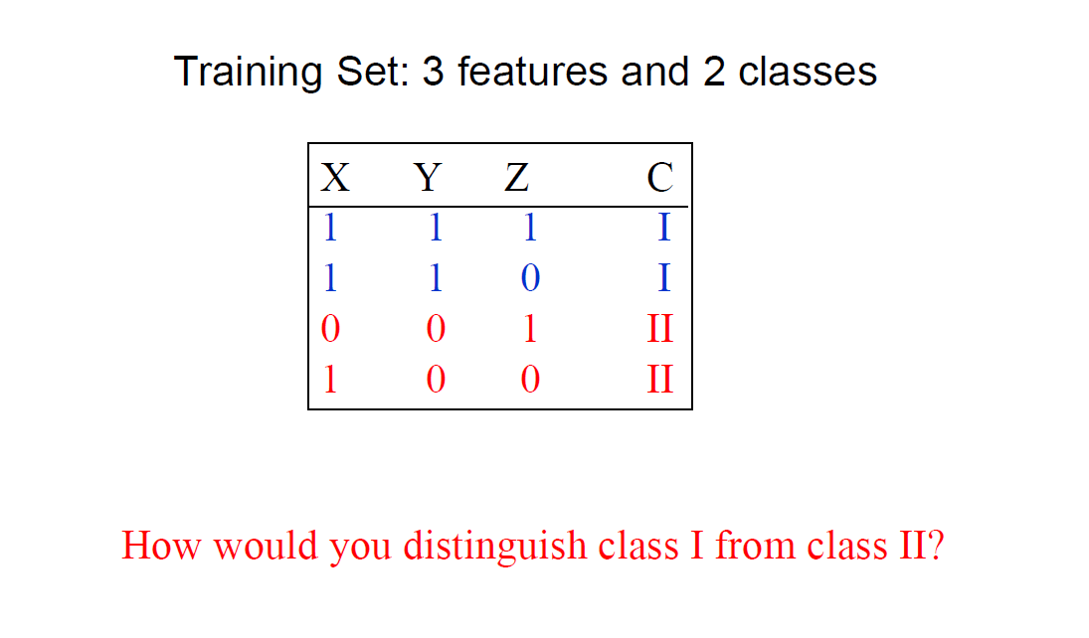
Example

Slide 42
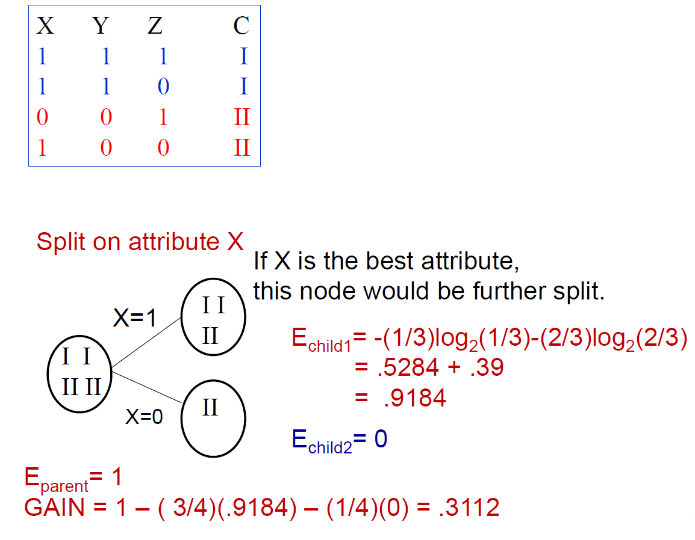
Split on Attribute X

Slide 43
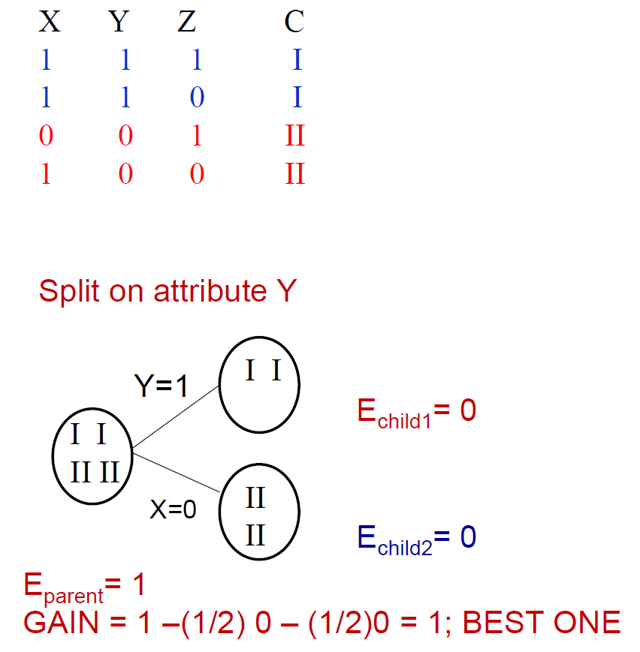
Split on Attribute Y

Slide 44
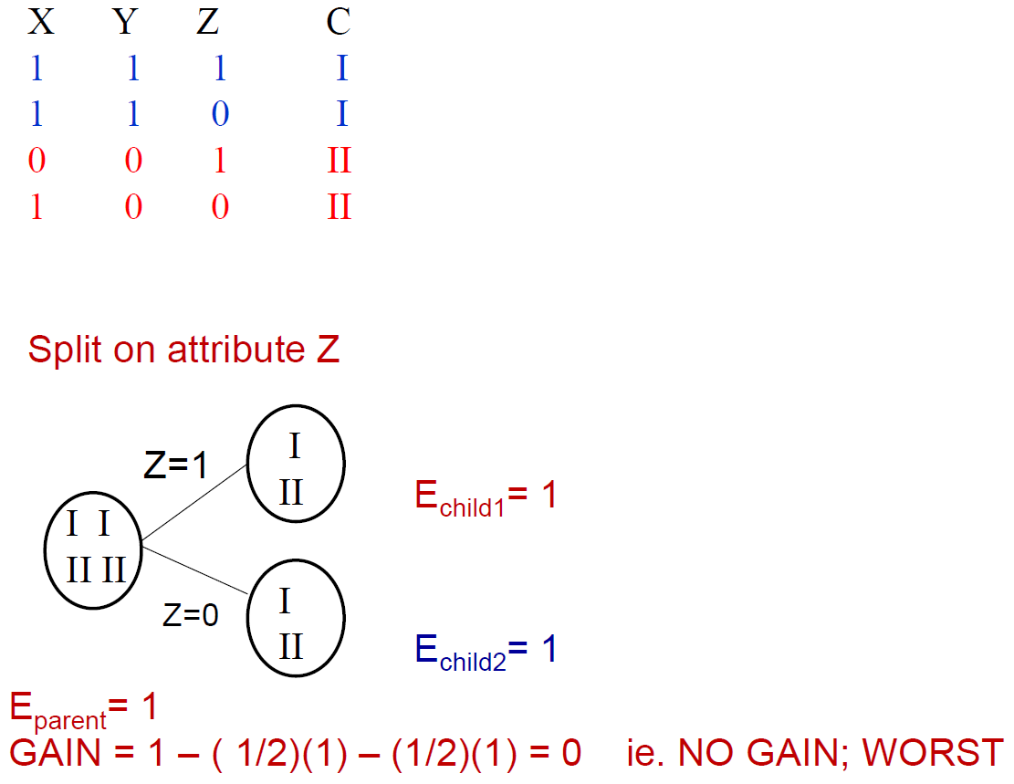
Split on Attribute Z

Slide 45
Entropy of the Parent Node
Entropy ; The measure of “learning potential” of a data set.
Total Samples t
Positive Samples p
Negative Samples n
→ t = p + n.
→ H[p/t, n/t] = - (p/t).log₂(p/t) - (n/t).log₂(n/t)

Slide 46
Entropy of the Child Nodes
“Weighted Average” or “Expected” Entropy
A chosen attribute A, with K distinct values, divides the training set E into subsets E₁, …, E_{k}
The Expected Entropy (EH) remaining after trying attribute A (with branches i-1,2,…,k)
Parent Node A
Child 1
Child 2
Child k

Slide 47
Information Gain
Reduction in Entropy for the attribute A
Entropy of
the
Parent Node
Entropy of the
Child Nodes

Slide 48
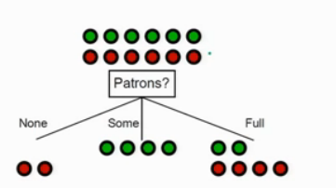

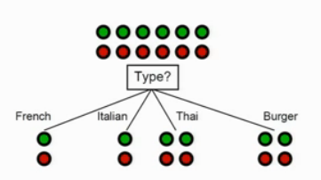
Example
.541

Slide 49
Learning Decision Tree
Pick each of the attributes one by one
Calculate Information Grain
Arrange the Attributes in descending order

Slide 50
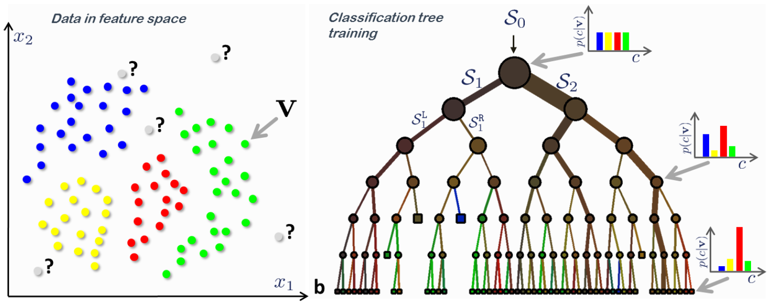
Complex Class Boundaries
S₀
S₁
S₂
2 dimensional data
Antonio Criminisi, 2011, Microsoft

Slide 51
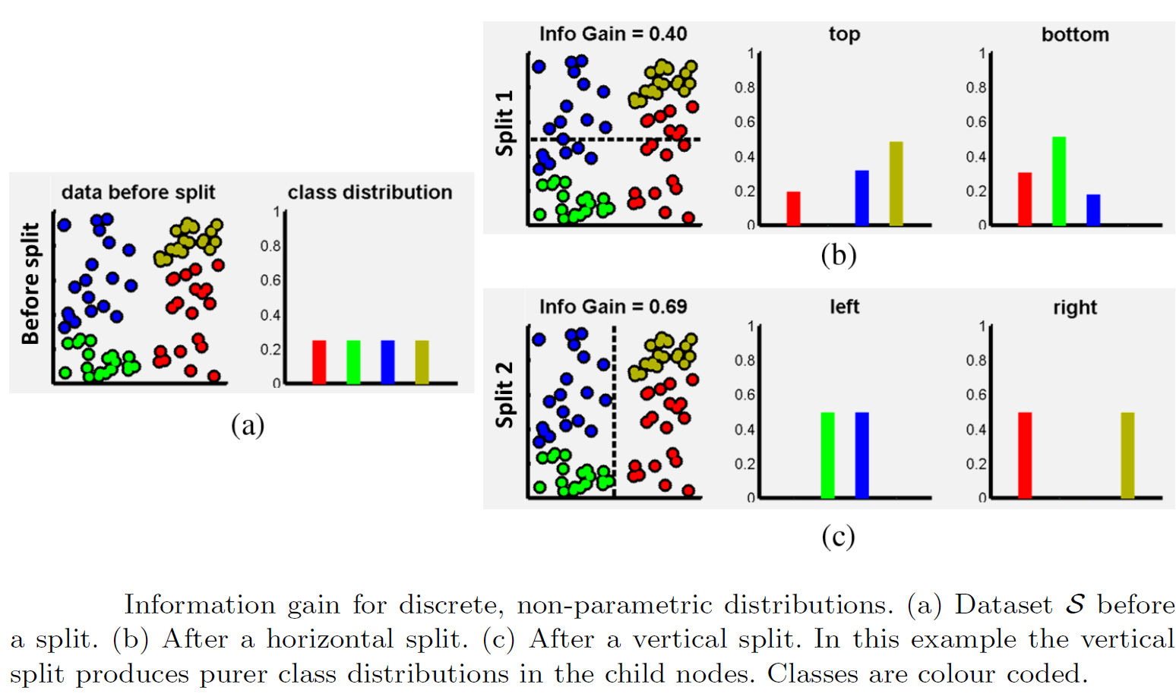
Antonio Criminisi, 2011, Microsoft

Slide 52
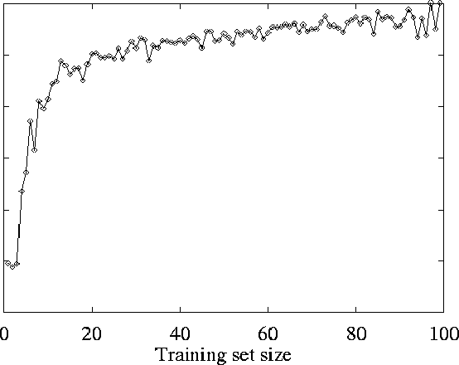
Restaurant Example: Learning Curve
On test set
Prediction quality:
Average Proportion correct on test set
As the training set increases,
so does the quality of prediction:
→“Happy curve” ☺!
→ the learning algorithm is able to capture
the pattern in the data

Slide 53
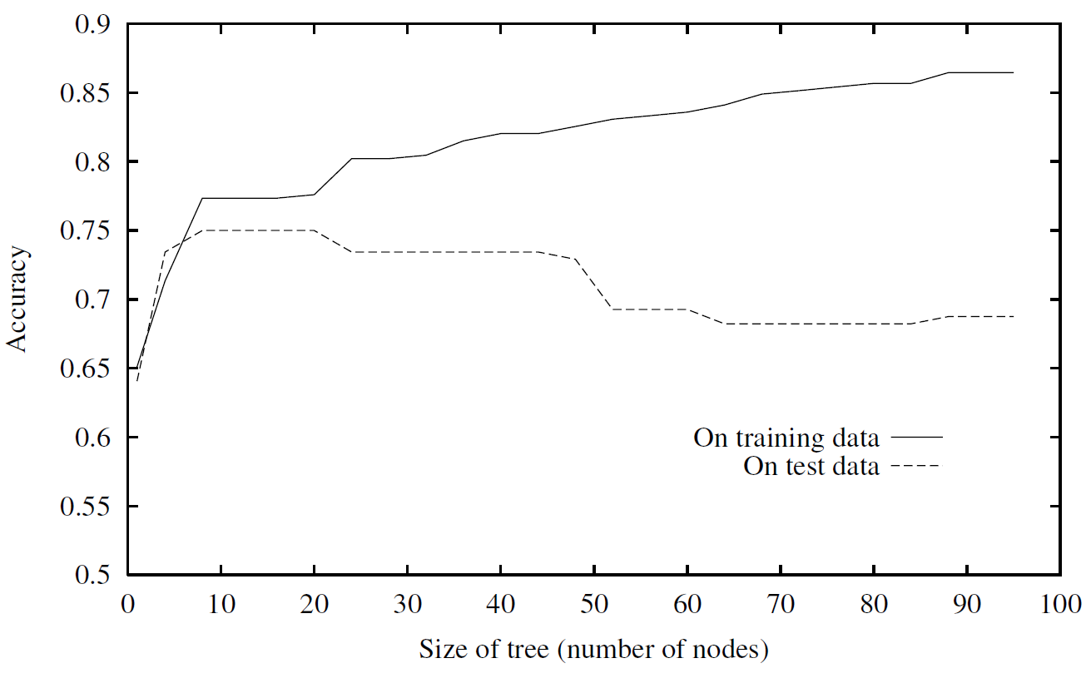
Overfitting
Machine Learning, Tom M. Mitchell, McGraw Hill, 1997

Slide 54
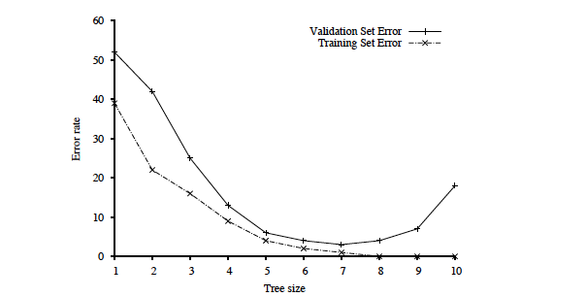
Key figure in machine learning
We set tree size as
a parameter in our
DT learning alg.
Optimal tree size
Error rate
Overfitting kicks in…
error_{T}(h) < error_{T}(h’) but
error_{D}(h) > error_{D}(h’)
Tree size
Note: with larger and larger trees,
we just do better and better on the training set!
But note the performance on the validation set…

Slide 55
Noisy data
Many kinds of "noise" that could occur in the examples:
Two examples have same attribute/value pairs, but different classifications
→report majority classification for the examples corresponding to the node
deterministic hypothesis.
→report estimated probabilities of each classification using the relative frequency (if considering stochastic hypotheses)
Some values of attributes are incorrect because of errors in the data acquisition process or the preprocessing phase
The classification is wrong (e.g., + instead of -) because of some error
One important reason why you don’t want to “overfit” your learned model.

Slide 56
Tools
You don’t find ‘pure’ ID3 too much
Other algorithms in a similar spirit to search for are C4.5 and Adaboost
Tools
Matlab implements decision tree induction
Weka toolkit (from Waikato Uni) has a variety of Java tools for machine learning
Try Pierre Geurts’ online decision tree induction applet, e.g., for ‘animal descriptions’ from http://www.montefiore.ulg.ac.be/~geurts/dtapplet/dtexplication.html#online

Slide 57
Summary: When to use Decision Trees
Instances presented as attribute-value pairs
Method of approximating discrete-valued functions
Target function has discrete values: classification problems
Robust to noisy data:
Training data may contain
errors
missing attribute values
Typical bias: prefer smaller trees (Ockham's razor )
Widely used, practical and easy to interpret results

Slide 58
Summary
Inducing decision trees is one of the most widely used learning methods in practice
Can outperform human experts in many problems
Strengths include
Fast
simple to implement
human readable
can convert result to a set of easily interpretable rules
empirically valid in many commercial products
handles noisy data

Slide 59
Summary
Weaknesses include:
"Univariate" splits/partitioning using only one attribute at a time so limits types of possible trees
large decision trees may be hard to understand
requires fixed-length feature vectors
non-incremental (i.e., batch method)

Slide 60
Est
0,10
10-30
30-60
>60

